Slide 1
Seasonality Package Test
Using Meta’s Prophet Package and Random Generated Data

Slide 2
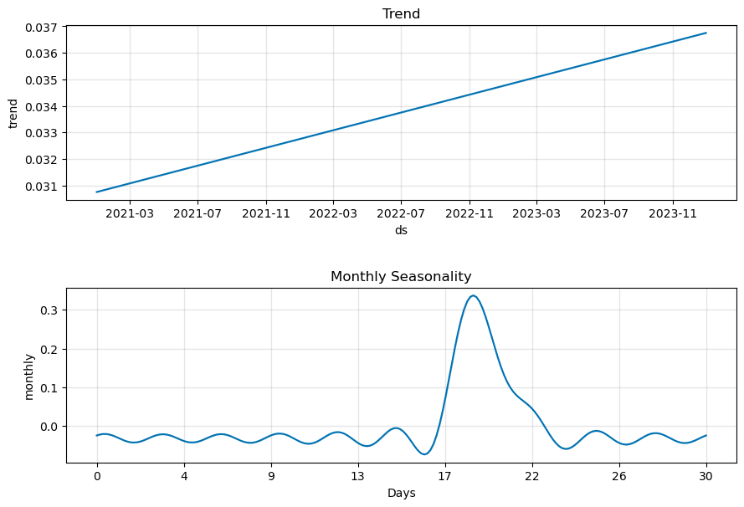
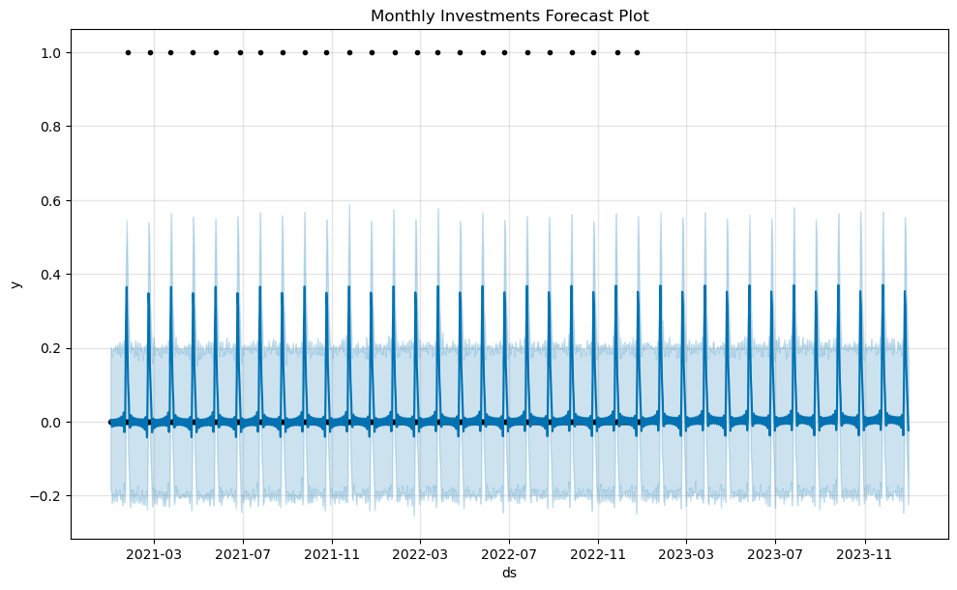
Scenario 1: Customer invests at around end of month

Slide 3
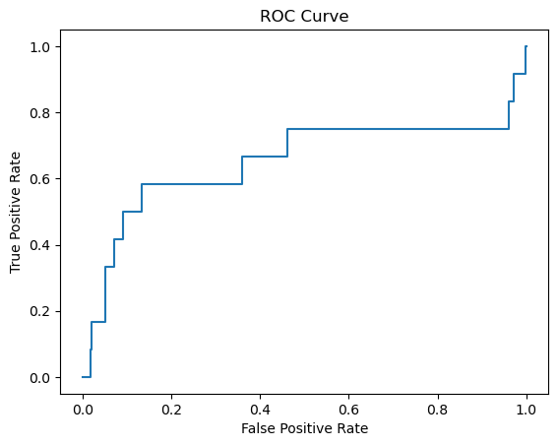
Scenario 1: Customer invests at around end of month

Slide 4
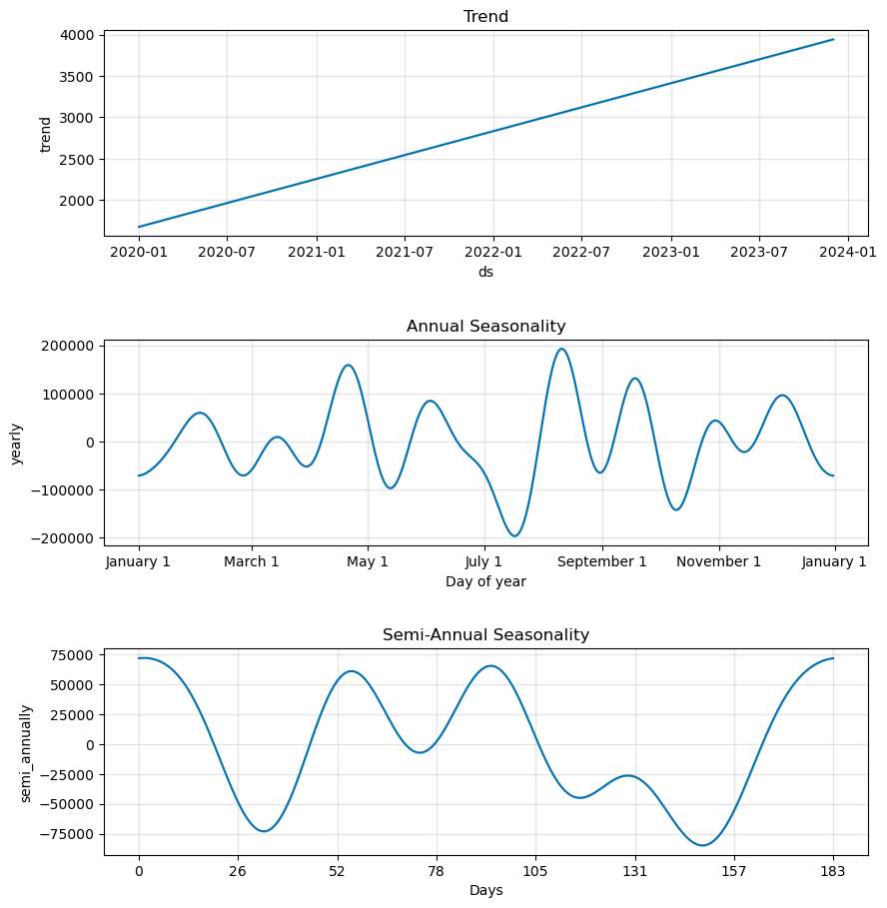
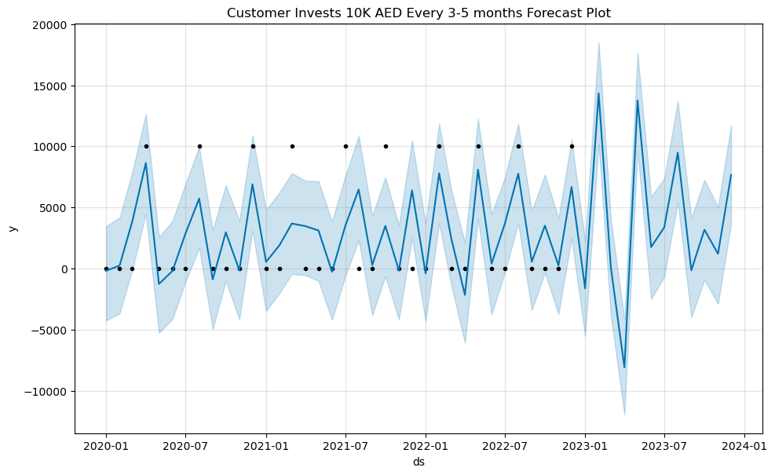
Scenario 2: Customer invest 10k AED every 3-5 months

Slide 5
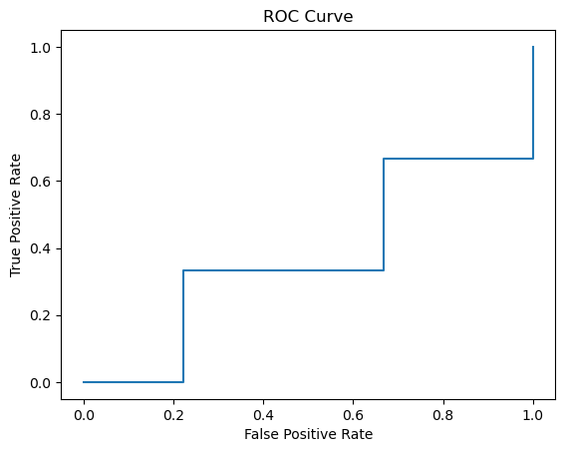
Scenario 2: Customer invest 10k AED every 3-5 months

Slide 6
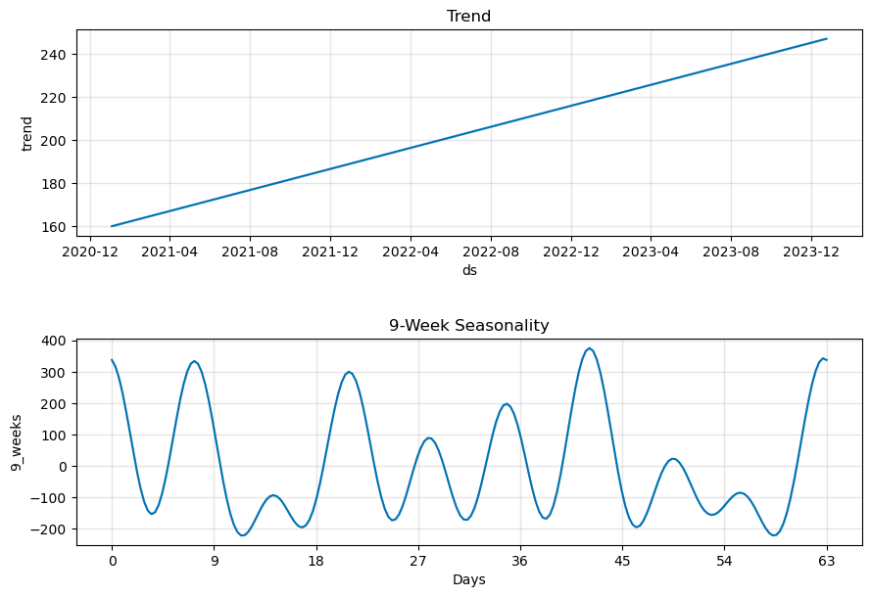
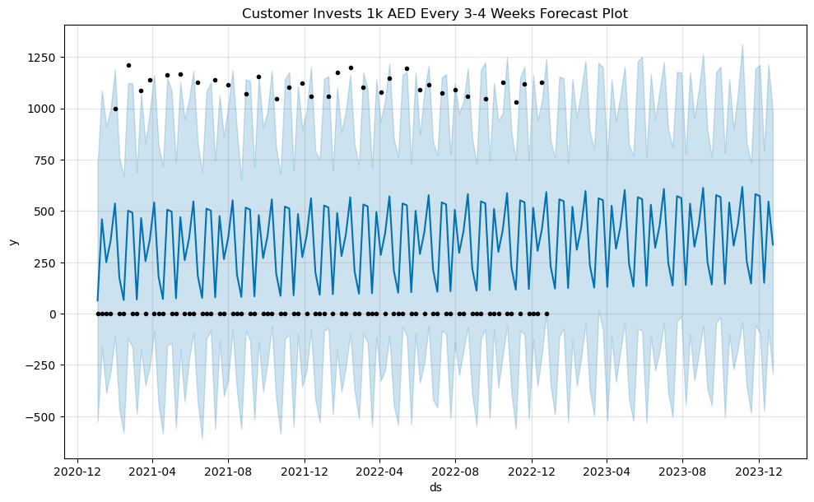
Scenario 3: Customer invests around 1000 AED every 3-4 weeks

Slide 7
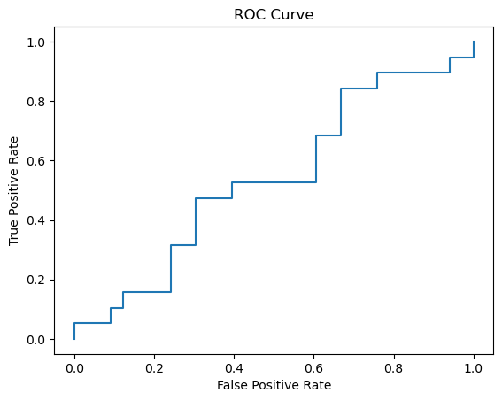
Scenario 3: Customer invests around 1000 AED every 3-4 weeks

Slide 8
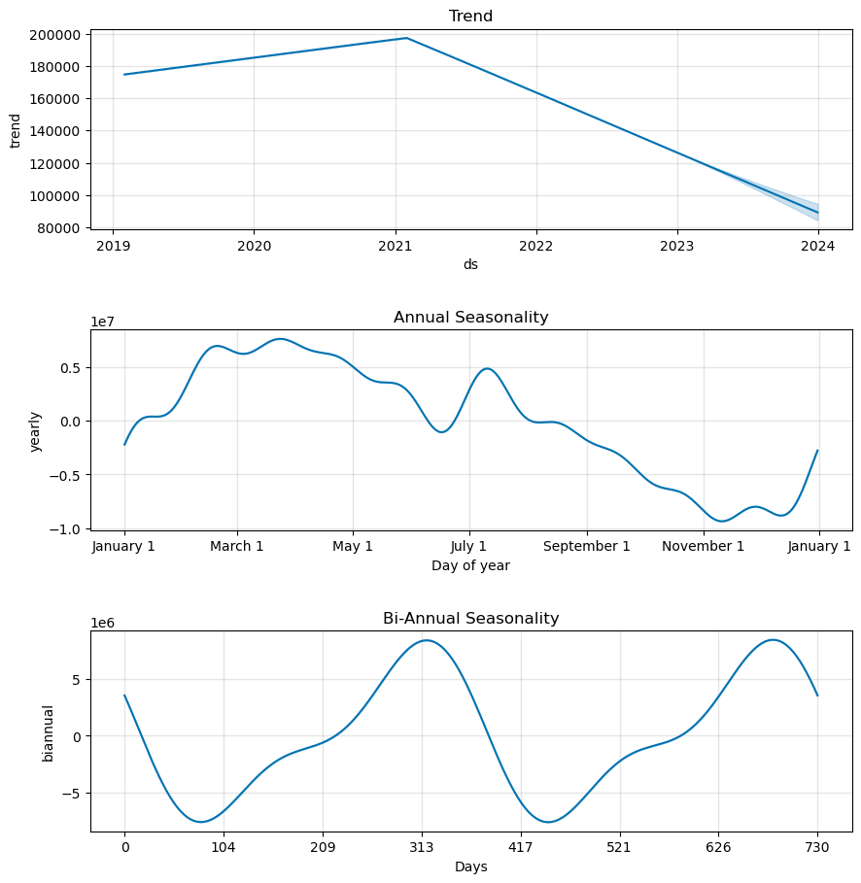
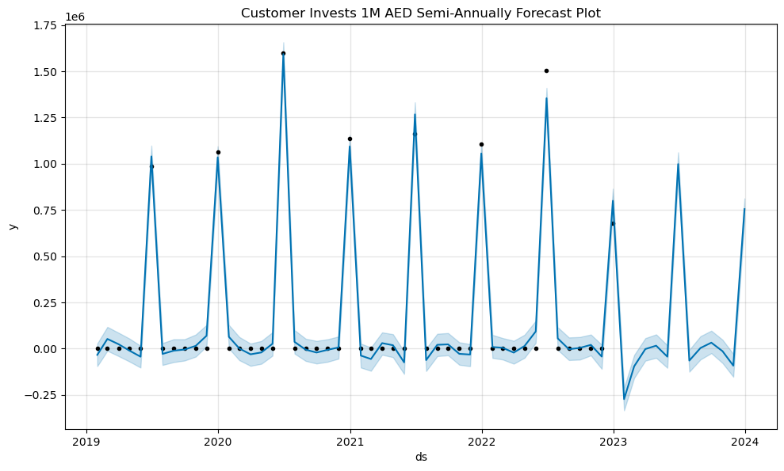
Scenario 4: Customer invests around 1M AED every 6 months

Slide 9
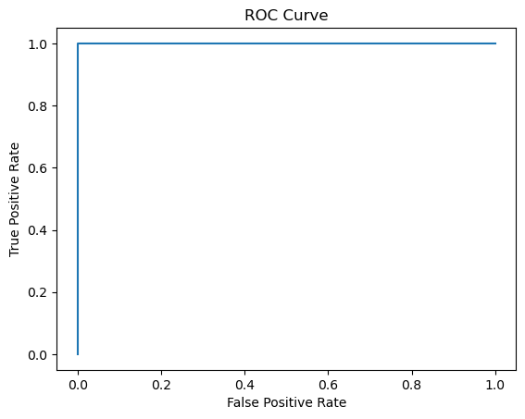
Scenario 4: Customer invests around 1M AED every 6 months

Slide 10
Suggestions
Data generation code for scenarios 2 and 3 add much randomness on the long run. Consider limiting training data to 3 periods.
Smooth data (moving average).
Test through different prior scales.
Cross Validate.
Consider if algorithm id off by a day or two.

